Slide 1
Courant Math 2799.001
Modeling & Risk Mgt of Bonds & Securitized Products
Lecture 7: ABS: CC, Autos, SL | Subprime ABS, CDOs | Gaussian Copula | MPL
May 6, 2024
Prof: Rodney Sunada-Wong rsw8@nyu.edu
TA: Edison Lee el2700@nyu.edu

Slide 2
Topics
Intermission 1: The impact of principal being paid early
Previous Homework (CLO waterfall)
ABS (non-mortgage-related Securitized Products)
Credit Card ABS
Auto ABS
Intermission 2: Bond convexity
Asset Liability Management
Key Takeaways
Subprime and CDOs
Key Lessons
Appendix
Credit Spreads – CMBS, Cards, Autos, SLABS
More about Default and Foreclosure
More about Subprime and CDOs – Vasicek’s Model (Gaussian Copula)
Student Loan ABS
Market Place Lending (MPLs)

Slide 3
Intermission: The impact of principal being paid early
Holding interest rates and volatility unchanged, how would MBS prices be impacted if ppmts speed up and
If the Passthrough is a “premium bond” (price > par)
1) YC is flat
2) YC is upward sloping
The impact on PV depends on
The level of forward rates
Compared to
The level of the coupon
In “Content”, see spreadsheet “PV as function of prepayment speed”

Slide 4
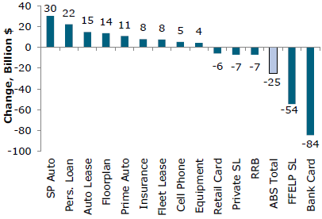
ABS (non-resi securitized products ex. CLOs, CDOs)
The total amount of commercial and consumer credit has grown the past several years
This data suggest ABS has become a less important source of funding for some lenders
Change in outstandings 2010-2017
Auto-related grew as the economy recovered from the financial crisis
MarketPlace Lending – a new category the past few years
Cell Phone Receivables
Alternative for investors vs tight corporate spreads
For Verizon, an alternate source of funding
FFELP (Student Loans) – no more issuance
Credit Cards ABS issuance down because:
Changes in regulatory capital
Funding with deposits has been very inexpensive
Sources: https://www.sifma.org/resources/archive/research/statistics/
Wells Fargo Securities; filenames: US-Asset-Backed-Securities-Statistics-SIFMA.xls,

Slide 5
Credit Cards
Credit Cards are issued by banks (VISA, Mastercard), retailers, travel companies (American Express)
Credit Card borrowers
May make just minimum monthly payments
Not obligated to pay down principal on a schedule
Borrowers would pay interest on any unpaid balance
Source: C. Mohebbi

Slide 6
Credit Cards
Credit Card receivables are non-amortizing loans
There is no schedule of periodic principal payments
“Prepayment” does not apply for a pool of credit card receivable loans
Two periods:
“Lockout” or “Revolving” period
Assets are added to the deal; period can last for years
“Amortizing” or “Accumulation” period
Current and accumulated payments are distributed to investors
If certain events occur, there can be early amortization of principal
Source: C. Mohebbi

Slide 7
Credit Cards
Cash flow mechanics
Investment: Credit card ABS, three-year bullet maturity
Bond cash flow ($100 MM investment)
Revolving period
Accumulation period
Collateral: Credit card accounts, monthly principal and interest receipts
Excess seller interest
Required seller interest
Collateral balance ($)
Investor interest
Source: JPMS.
Revolving period
Accumulation period
Source: C. Mohebbi

Slide 8
Credit Cards: Master Trust
Receivables generated from a group of designated accounts are sold to the trust
Allows for issuance of multiple series from the same pool of receivables
Senior class investors have an equal pro rata interest in the same assets
Provides maximum flexibility in both basis and term
Nearly every Credit Card ABS issuer uses the Master Trust structure
Seller
Master Trust
Series A
Series B
Series X
Certificates
Certificates
Certificates
Source: C. Mohebbi

Slide 9
Credit Card ABS performance metrics
Monthly Payment Rate (MPR) used with non-amortizing assets, such as credit card and dealer floorplan receivables, which are not subject to prepayment
A repayment measure calculated by dividing the sum of the interest and principal payments received in a month by the outstanding balance.
Rating agencies require every non-amortizing ABS issue to establish a minimum MPR as an early-amortization trigger event
If repayments drop to that level, the security enters into early amortization.

Slide 10
Credit Card ABS performance metrics (cont’d)
Other metrics:
Gross Portfolio Yield: finance charges collected and fees as a proportion of the credit card debt outstanding
Charge-offs: accounts charged off as uncollectable as a proportion of the credit card debt outstanding
Net portfolio Yield: gross profit yield minus charge-offs as a proportion of the credit card debt outstanding
Delinquency Rate: Proportion of receivables past due
30, 60, or 90 days

Slide 11
Credit Cards
Credit Cards are issued by banks (VISA, Mastercard), retailers, travel companies (American Express)
Credit Card borrowers
May make just minimum monthly payments
Not obligated to pay down principal on a schedule
POLLs:
1) What interest rate are you earning on your checking account?
2) If you have a credit card, what is the annual interest rate on your unpaid balance?
Source: C. Mohebbi

Slide 12
Autos ABS
Automobile loan-backed securities issued by
Captive financial subsidiary of auto company
Commercial banks
Finance companies specializing in auto loans
Loan maturities typically less than 7 years
Typically amortizing
Typically a two-step securitization:
Manufacturer sells loans to sub
Sub sells loans to SPV
ABS issue typically has higher rating than manufacturer’s rating

Slide 13
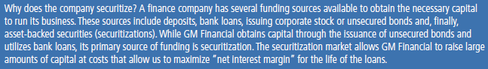
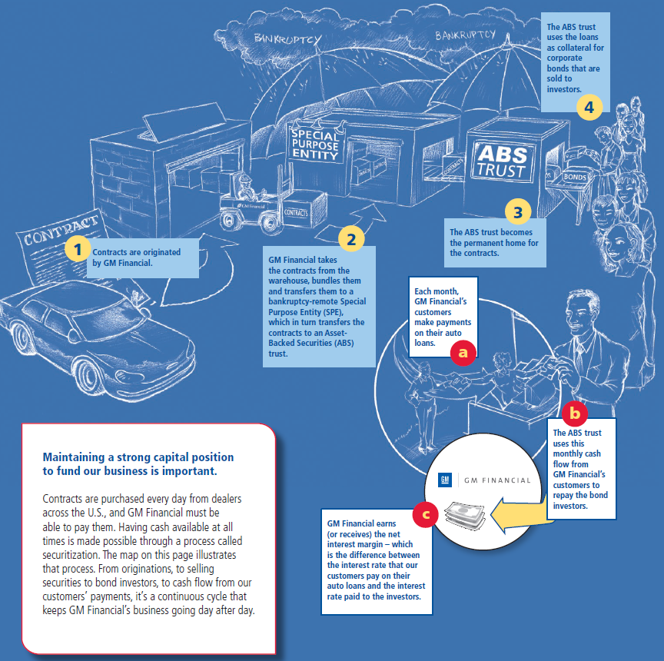
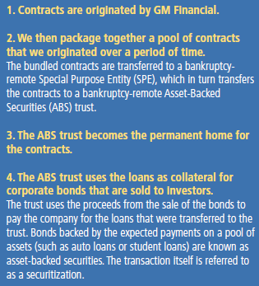

Autos ABS
Source: https://www.gmfinancial.com/Docs/About-Us/understanding-securitizations.pdf

Slide 14
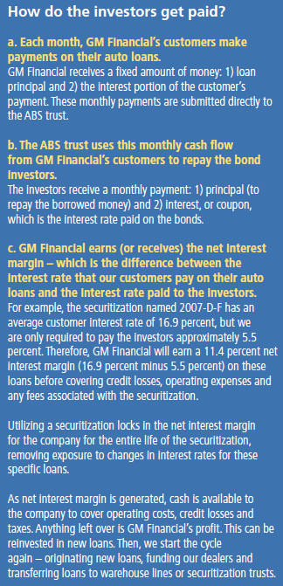
Autos ABS
Source: https://www.gmfinancial.com/Docs/About-Us/understanding-securitizations.pdf

Slide 15
Autos
Static Structure: Owner Trust
Underlying Asset Cashflows: Retail auto installment contracts, 60 mo term, monthly P&I
Principal
Bond Cashflows
Source: C. Mohebbi

Slide 16
Autos
Time-tranched into Sequentials
Underlying Asset Cashflows: Retail auto installment contracts, 60 mo term, monthly P&I
Principal
Charge-offs % vs Excess Spread %
Bond Cashflows
Source: C. Mohebbi

Slide 17
Autos
The primary structure used in Auto ABS:
Flexibility in structuring cash flows permits multiple senior tranches:
“Money Market” tranches
“Total rate of return” tranches with principal lockout periods
Fixed rate and Floating rate tranches
SPV has IR swap to manage IR risk
Credit enhancement for senior notes typically provided by subordinated certificates and reserve account
Owner Trust
Obligors
Seller/
Servicer
Bankruptcy remote sale
Reserve
Fund
Owner Trust
Issuer
A-1
Notes
A-1+/P-1
Class A-2
Notes
AAA
Class A-3
Notes
AAA
Class A-4
Notes
AAA
Class B
Certs
A
Investors
Investors
Investors
Investors
Investors / Retained
Source: C. Mohebbi

Slide 18
Intermission: Bond and Mortgage Convexity
Bonds are positively convex
Mortgages are negatively convex!
Why?
In “Content”, see spreadsheet “PV as interest rates change”

Slide 19
Asset Liability Management (ALM) and SVB, SB and FRB*
What does this “saying” mean: “Banks borrow short and lend long”
Bank deposits (e.g. checking accounts) can be withdrawn by customers at any time
But banks’ loans to borrowers in the form of mortgages or loans to companies which may last for years
Are there economic incentives for banks to do this?
Yes, the yield curve is usually upward sloping
If customers can withdraw their deposits at any time, doesn’t this create a large “liquidity” risk? (i.e. the risk that they run out of cash when borrowers withdraw their deposits?
Yes, so banks have to be very careful to model the behavior of their customers
How long have you had your cash in your checking account?
* Silicon Valley Bank, Signature Bank, First Republic Bank

Slide 20
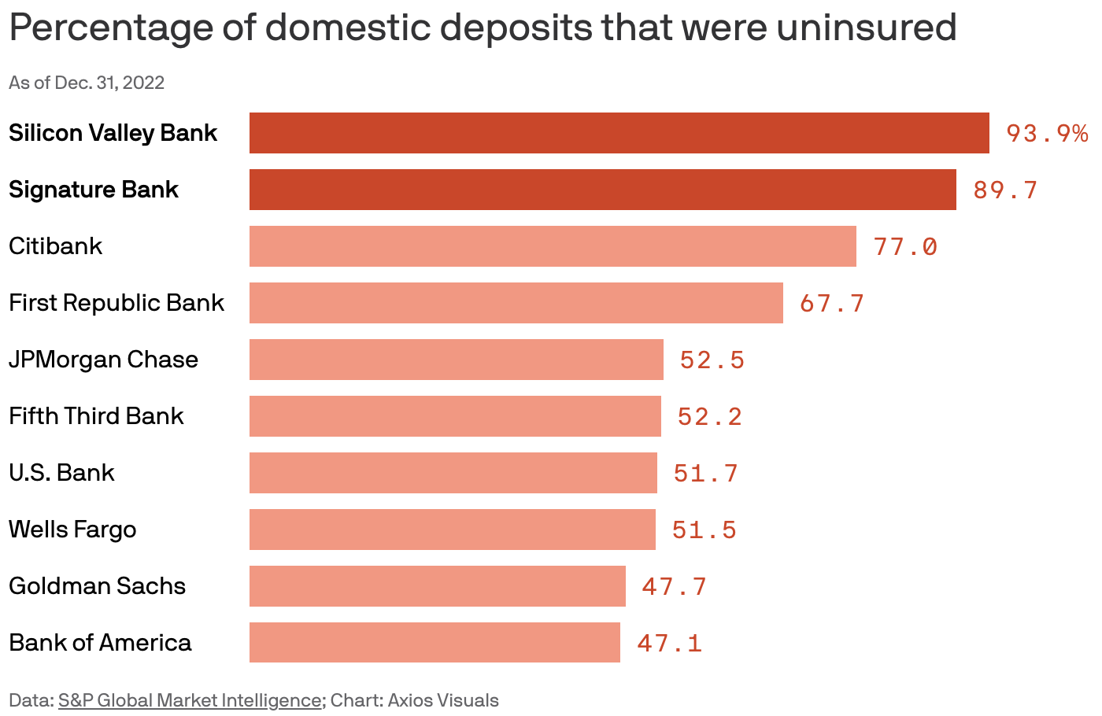
ALM: Rudimentary deposit-modeling
Some concepts:
1) Stickiness of deposits depends on the profile of the depositor
(similar in concept to how prepayment behavior depends on the profile of the borrower)
Which kinds of depositors are quicker to pull their deposits out, and which ones are slower to pull their deposits out?
Smaller depositors may use the great majority of the amounts for day-to-day management of cash e.g. “direct-deposit” of salary, paying bills => they may not have much excess to move into other assets e.g. T-Bills
FDIC insurance insures the first $250k => smaller depositors checking accounts are likely fully-insured
Large depositors may have amounts in their account exceeding $250k
Large depositors are, on-average, more sophisticated, mobile, interest-rate sensitive than smaller depositors

Slide 21
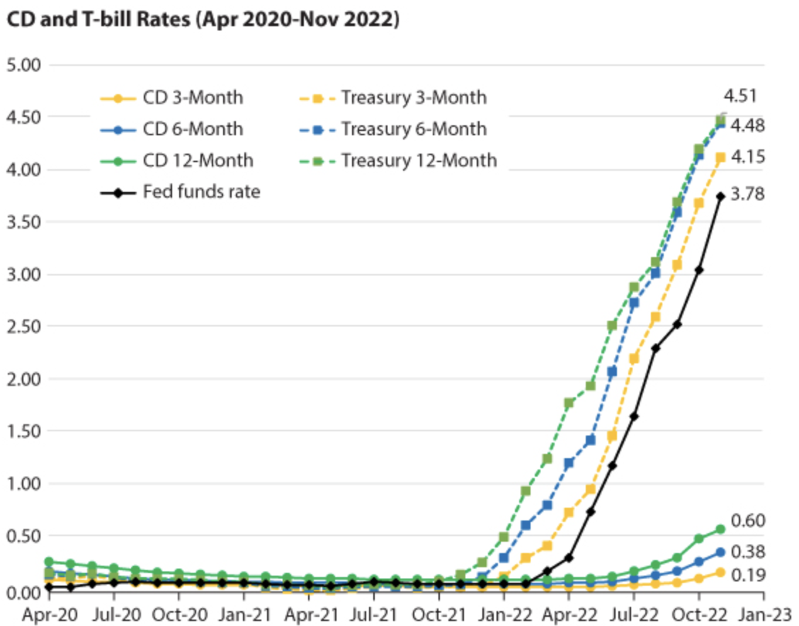
ALM: Rudimentary deposit-modeling
Some concepts:
2) Deposit Beta: the speed at which the rate the bank pays the depositor changes
the speed at which short term interest rates change
https://research.stlouisfed.org/publications/economic-synopses/2022/12/16/where-do-you-keep-your-liquid-wealthbank-deposits-or-t-bills

Slide 22
ALM: Rudimentary deposit-modeling
Some concepts:
2) Deposit Beta: the speed at which the rate the bank pays the depositor changes
the speed at which short term interest rates change
If the Beta is small, then the interest rate duration of the checking account liability can be high e.g. years
If the Beta is large e.g. 1, then the duration is small e.g. 1-day
If the beta of a bank’s deposits is small, then
the interest rate duration of their liabilities is large, and
the bank can buy assets that have significant interest rate duration, and
the net interest rate duration of assets and liabilities will be small.
However, if the beta of the deposits is large, then the net duration will not be small

Slide 23
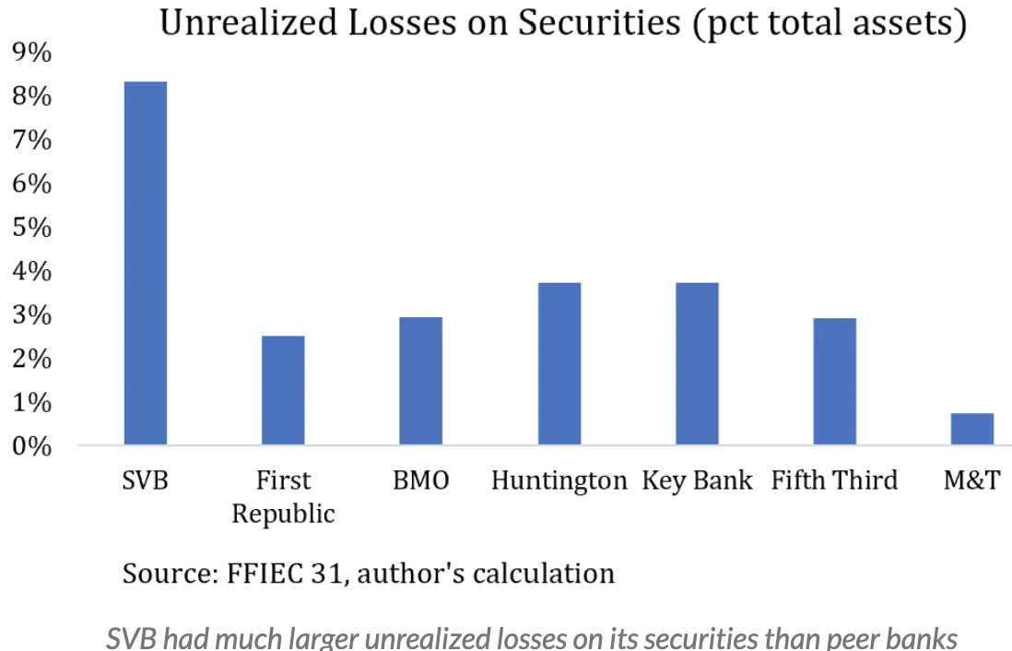
ALM: Key Takeaways
A bank with a significant percentage of large depositors
Has to pay interest rates competitive with short term interest rates, else depositors may leave if the FED raises short term interest rates, so their deposits will not have much duration => the bank should avoid buying long-duration assets
Deposits may not be “sticky”; deposits may be “hot”
In addition, depositors may have large amounts of money that are not insured, and they may withdraw if there is bad news about the bank
SVB, SB, FRB had long-duration assets (bonds and mortgages), and so with large increase in the yield curve, the PV of those assets dropped significantly
Note that SVB and FRB had significant amounts of fixed income bonds, for which banks are obligated to disclose the unrealized mtm loss (“Other Comprehensive Income”)
https://fedguy.com/hidden-to-market/

Slide 24
ALM: Rudimentary deposit-modeling
Some concepts:
2) Deposit Beta: the speed at which the rate the bank pays the depositor changes
the speed at which short term interest rates change
If interest rates rise, for which kinds of depositors would banks have to increase rates more quickly than for other kinds of depositors?
Same answer as for the stickiness question: large depositors may move their cash out and reinvest in t-bills if short term rates rise and if the beta of the deposits is small
Therefore, a bank that has a lot of large

Slide 25
Subprime
The GSE’s impose credit requirements on loans that they are willing to purchase
Characteristics of the borrower, loan and property such as:
Credit score (FICO, Vantage, etc.)
Debt-To-Income (DTI) ratio
Loan-to-value ratio (LTV)
For example, in September 2013, a loan with an LTV>75% must have had a FICO of 680 or higher in order to have been sold to Freddie Mac
A loan which does not meet these requirements is called a subprime loan
Source: Kevin Atteson (Summer Road) -- Math 2796 Courant guest lecturer March 4, 2014

Slide 26
Credit Tranching (revisited)
Prior to the financial crisis, investment banks would buy pools of subprime loans, package them into bonds and sell them off
Subprime Resi ABS
loan
loan
loan
Principal payments pay down from the top of the structure down
Losses written down from the bottom of the structure up
loan
loan
Class A (AAA) 90.25%
loan
~5,000 loans
loan
loan
loan
loan
loan
Class M-1 (AA) 5.00%
loan
Class M-2 (A) 2.25%
loan
Class B (BBB) 2.50%
loan
Overcollat 1.95%
loan
Excess
In 2006, mortgage research teams assumed lifetime cumulative default losses of ~3%
At 3% default rate, if loans default independently, there is ~10⁻⁸² probability the AAA tranche takes writedowns.

Slide 27
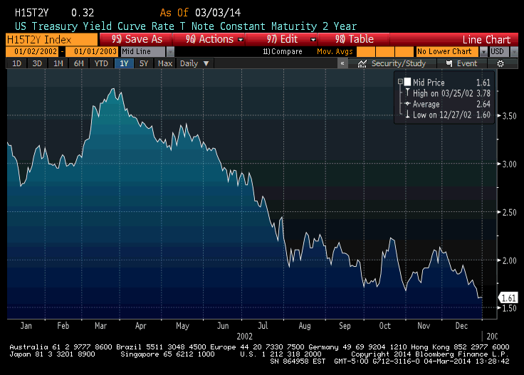
The Mortgage Originator’s Perspective in 2002
State of subprime world:
Cum losses on subprime pools <4% over life of subprime loan
Rates on loans >8%
2 year Treasuries <2%, 10 year Treasuries ~4%
So subprime mortgage originators could have assets with yields more than 3% in excess spread
So: originators quickly fill up their balance sheets with subprime mortgages
Source: Kevin Atteson (Summer Road) -- Math 2796 Courant guest lecturer March 4, 2014

Slide 28
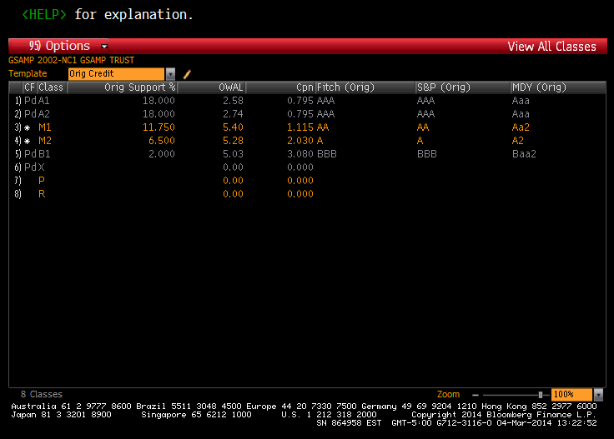
A Sample Subprime Deal
At 3% default rate, if loans default independently, there is ~10⁻⁸² probability that the AAA tranche takes writedowns.
Source: Kevin Atteson (Summer Road) -- Math 2796 Courant guest lecturer March 4, 2014

Slide 29
The Rating Agencies
Credit rating agencies rate the creditworthiness of debt issuances
The major credit rating agencies are:
Moody’s – Rating is based upon expected loss
S&P – Rating is based upon probability of default
Top rating ~0.01% annual
Rating agencies are paid to rate new deals
Moody’s | S&P
Aaa | AAA
Aa1 | AA+
Aa2 | AA
Aa3 | AA-
A1 | A+
A2 | A
A3 | A-
B1 | BBB+
B2 | BBB
B3 | BBB-
Source: Kevin Atteson (Summer Road) -- Math 2796 Courant guest lecturer March 4, 2014

Slide 30
Subprime Deals and Investors
The senior bonds:
The AAA bonds on subprime deals were paying higher spreads than corresponding corporate bonds
Gradually, over time, investors bought these AAA bonds until the spreads converged to corporate bond spreads
However, the deals were only marketable if the junior bonds could be sold as well:
There were few risk-seeking investors who would invest in these high-risk bonds
Starting around 2003 or so, these bonds were put into CDO’s
At first, a few subprime bonds were mixed with corporate bonds…
Source: Kevin Atteson (Summer Road) -- Math 2796 Courant guest lecturer March 4, 2014

Slide 31
CDO’s
Pool together 5,000 subprime loans
ABS Deal #123
Pool together BBB tranches from 100 different ABS deals
CDO
ABS Deal #456
ABS Deal #789
Assets
Liabilities
Assets
Liabilities
loan
Pool of loans
AAA 90.25%
#123 BBB
Pool of 100 BBB tranches
Super Senior
loan
#456 BBB
loan
#789 BBB
loan
#234 BBB
loan
The Super Senior has 40% subordination
loan
#890 BBB
loan
#678 BBB
loan
#567 BBB
loan
#345 BBB
#901 BBB
loan
.
.
.
.
.
.
Question:
What is the probability that defaults can eat through the 40% of subordination?
AA 5.00%
A 2.25%
Subordinate Bonds
BBB 2.50%
OC 1.95%
Source: Kevin Atteson (Summer Road) -- Math 2796 Courant guest lecturer March 4, 2014

Slide 32
The situation in the early 2000’s:
We had:
Rating agencies rate senior subprime bonds and CDO tranches AAA yielding significant profits for rating them
Investors buying the senior pieces of subprime bonds and making the same or better spreads than comparable corporate bonds
Investors buying CDO tranches which contain the junior subprime bonds and pay even better spreads
Investment banks create and sell subprime bonds and keep the highly risky but profitable residual pieces
Mortgage originators sell their pools of subprime loans to Wall Street for prices in $102 - $105 per $100 of notional
It takes typical originators a few months to originate a pool of subprime loans
Rather than making 3% per year, these originators now make 2%-5%within a few months
Source: Kevin Atteson (Summer Road) -- Math 2796 Courant guest lecturer March 4, 2014

Slide 33
Boom Times
Over time, subprime rates went down to around 6%:
There was significant demand for the loans which seemed profitable to everyone
The Fed continued to drive interest rates down
Due to lower rates, US house prices experienced a historical boom as people could afford more expensive houses
The subprime deals performed as expected:
Many subprime borrowers refinanced into lower rate loans
Even borrowers who couldn’t refinance could sell their houses for a profit
Source: Kevin Atteson (Summer Road) -- Math 2796 Courant guest lecturer March 4, 2014

Slide 34
Then the World Changed
In 2004, the Fed began to raise interest rates…
As rates rose, by late 2006, demand for housing dried up
Subprime borrowers:
Could no longer refinance their loans
Could no longer sell their houses
Many defaulted
Many subprime bonds defaulted over time
Many CDO’s defaulted over time
Source: Kevin Atteson (Summer Road) -- Math 2796 Courant guest lecturer March 4, 2014

Slide 35
The Financial Crisis
Excerpt from “Too Big to Fail” (2009), Andrew Ross Sorkin
“Morgan Stanley had undertaken a loan-by-loan analysis of the portfolio of the two mortgage giants, shipping reams of mortgage data from Fannie Mae and Freddie Mac off to India, where some thirteen hundred employees in Morgan's analytic center went through the numbers on every single loan - nearly half of the mortgages in the entire United States.”
Source: Kevin Atteson (Summer Road) -- Math 2796 Courant guest lecturer March 4, 2014

Slide 36
Lessons Learned
For the most part, market participants acted according to their short-term incentives
Subprime bonds are not corporate bonds
There is a need to “peel the onion” and understand financial instruments at as detailed a level as possible
Macroeconomic feedback cycles, which are difficult to model, can overwhelm more easily modeled factors
NEVER FORGET “MODEL RISK”
Source: Kevin Atteson (Summer Road) -- Math 2796 Courant guest lecturer March 4, 2014

Slide 37
Appendix
Credit Card ABS history
Auto ABS history
Resi: What happens in Default and Foreclosure?
More about Subprime and CDO’s – Vasiceck’s Model
Student Loan ABS
Market Place Lending (MPLs)

Slide 38
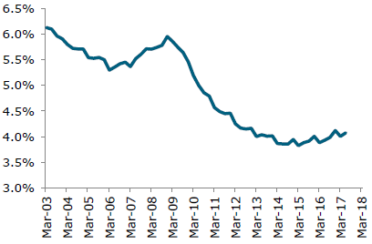
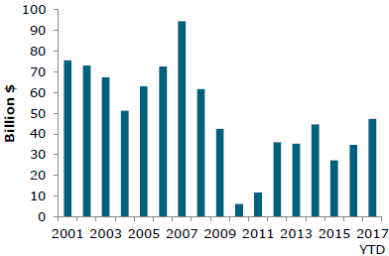
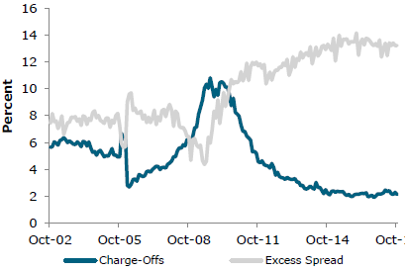
Credit Card Issuance, Performance
Credit Card Debt % of Nominal GDP
Total Credit Card Debt has grown slowly – borrowers seem disciplined
As noted before, Credit Card ABS issuance is down from pre-crisis
Charge-offs as a % are down
Excess spread is much higher than pre-crisis, serving as protection for investors
Credit Card Issuance
Charge-offs % vs Excess Spread %
Sources: Wells Fargo Securities, Intex, Bloomberg, Bureau of Economic Analysis, FRBNY

Slide 39
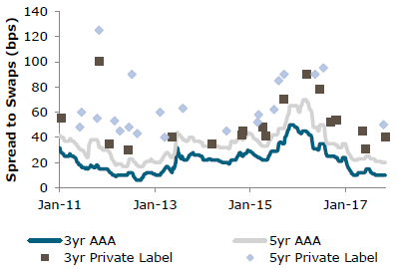
Spread History – Credit Cards, Autos
Retail Credit Card ABS (e.g. Macy’s, Neiman Marcus, J.Crew…
Riskier than bank-issued Credit Card ABS
Source of funding for “Bricks-and-mortar” retail
Retail CC ABS vs Bank CC ABS
Source: Wells Fargo Securities

Slide 40
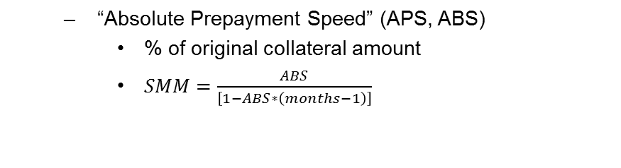
Autos prepayments
There can be prepayments, but:
Driven by car purchase, trade-in, accident, repossession
Not driven by the level of interest rates
“Absolute Prepayment Speed” (APS, ABS)
% of original collateral amount
$SMM=\frac{ABS}{\left[1−ABS∗\left(months−1\right)\right]}$
Source: C. Mohebbi

Slide 41
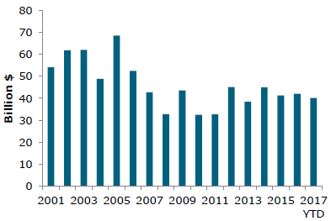
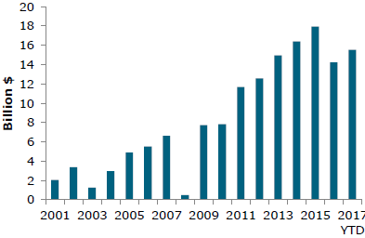
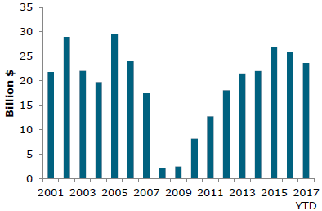
Auto ABS Issuance
Prime Auto ABS Issuance
These graphs show issuance for three categories
Auto Lease ABS Issuance
SubPrime Auto ABS Issuance
Sources: Wells Fargo Securities, Asset-Backed Alert, Bloomberg, Informa Global Markets

Slide 42
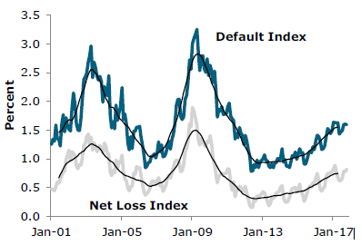
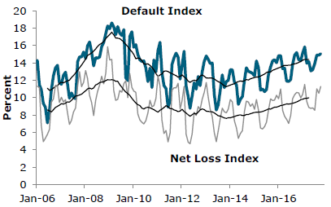
Auto ABS Credit Performance
Prime Auto ABS
These graphs show credit performance for two categories
SubPrime Auto ABS
Sources: Wells Fargo Securities, Intex,

Slide 43
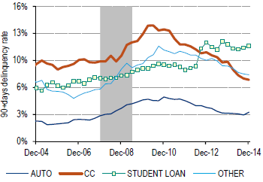
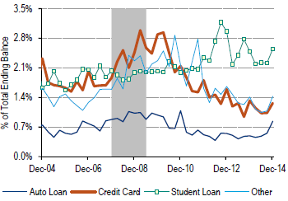
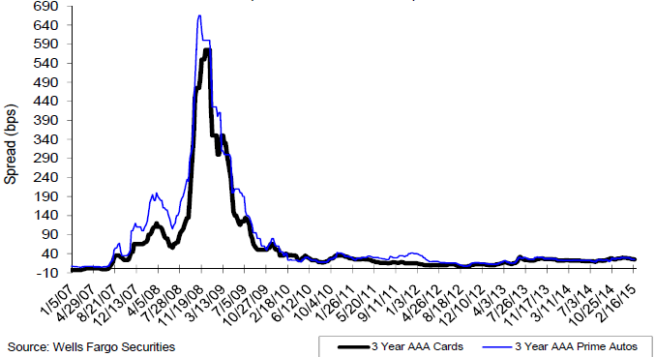
Auto, CC, Student Loan ABS – delinquency, spread comparison
Seriously delinquent rate
% of balances delinquent
Source: Bank of America Merrill Lynch “Securitized Products Strategy” Feb 20, 2015
Swap spreads
Source: Wells Fargo Securities “Fixed Income Market & Portfolio Strategy” Feb 24, 2015
Source: Barclays Live

Slide 44
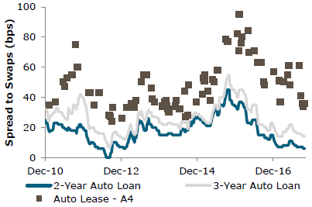
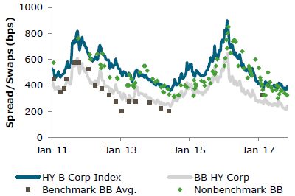
Spread History –Autos
Auto Loan vs Lease
SubPrime Auto ABS BB vs High Yield
Source: Wells Fargo Securities

Slide 45
Resi: What Happens When a Borrower Defaults?
If a borrower does not make payment for several months, typically 3, the borrower goes into default
The mortgage owner has the right to “foreclose” on the home and sell it to pay off the loan. The foreclosure process can take several months to a few years.
After a property is foreclosed on and owned by the lender, the loan is said to be “Real-Estate Owned”, or REO
Foreclosure laws are at the state level: every state has a different foreclosure process. For details, see:
http://www.realtytrac.com/real-estate-guides/foreclosure-laws/
There are two categories of foreclosure:
Judicial – the foreclosure is executed by a court hearing
Non-judicial – the foreclosure does not require a court hearing, making it significantly faster
Source: Kevin Atteson (Summer Road) -- Math 2796 Courant guest lecturer March 4, 2014

Slide 46
What Happens After Foreclosure?
After a lender forecloses on a property, takes ownership and then sells the property:
The lender pays off any missed taxes, etc.
The lender reimburses itself for foreclosure costs such as legal fees, etc.
The lender pays itself any outstanding amount on the loan(s) on the property, to whatever extent possible
Any further amount would be paid to the borrower
The loss on the loan as a result of foreclosure is referred to as the loss severity
Loss severities are frequently modeled by linear regression:
Since severities are positive, this model is subject to the same issues as linear regression models of transition probabilities
Nonlinear least-squares is a better model for severities
Source: Kevin Atteson (Summer Road) -- Math 2796 Courant guest lecturer March 4, 2014

Slide 47
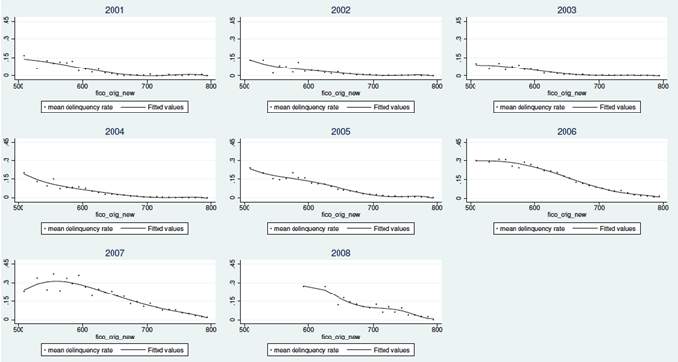
Subprime: FICO versus Mortgage Deliquency
Adjustable Rate Mortgages delinquent within 24 months by FICO and origination year
Source: SF Fed
Source: Kevin Atteson (Summer Road) -- Math 2796 Courant guest lecturer March 4, 2014

Slide 48
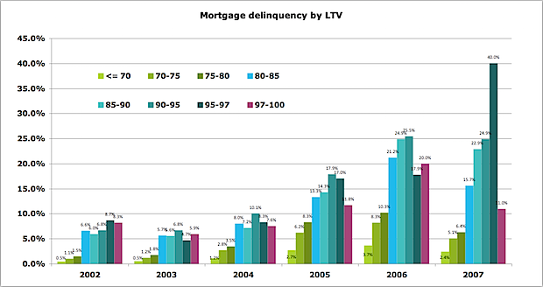
Mortgage Delinquency as a function of LTV
Source: Kroll via Felix Salmon
Source: Kevin Atteson (Summer Road) -- Math 2796 Courant guest lecturer March 4, 2014

Slide 49
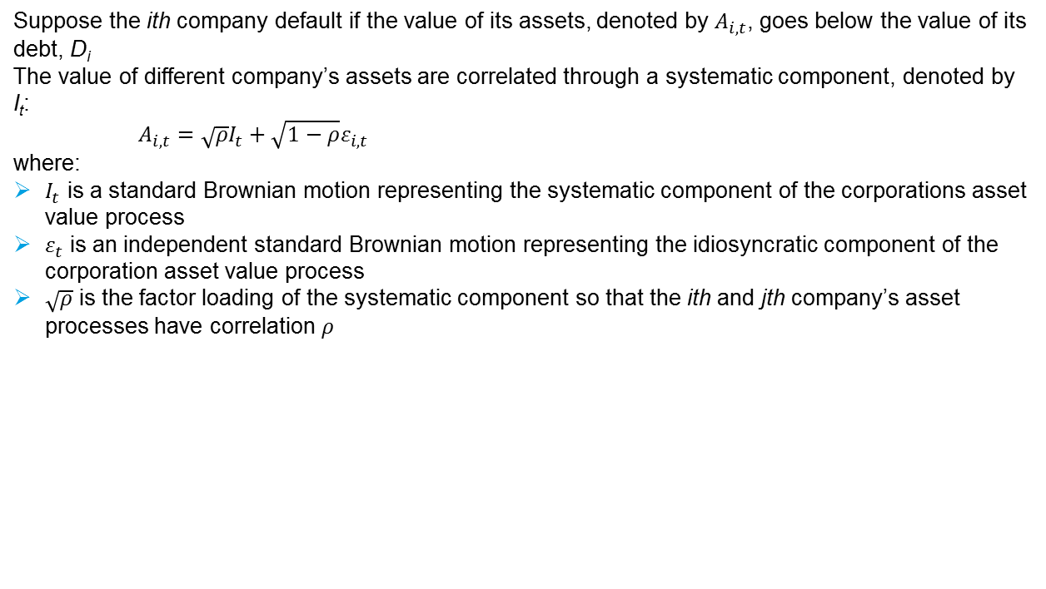
Vasicek’s Model (Gaussian Copula)
Suppose the ith company default if the value of its assets, denoted by $A_{i,t}$, goes below the value of its debt, D_{i}
The value of different company’s assets are correlated through a systematic component, denoted by I_{t}:
$A_{i,t}={\sqrt{ρ}I}_{t}+{\sqrt{1−ρ}ε}_{i,t}$
where:
$I_{t}$ is a standard Brownian motion representing the systematic component of the corporations asset value process
$ε_{t}$ is an independent standard Brownian motion representing the idiosyncratic component of the corporation asset value process
$\sqrt{ρ}$ is the factor loading of the systematic component so that the ith and jth company’s asset processes have correlation $ρ$
Source: Kevin Atteson (Summer Road) -- Math 2796 Courant guest lecturer March 4, 2014

Slide 50
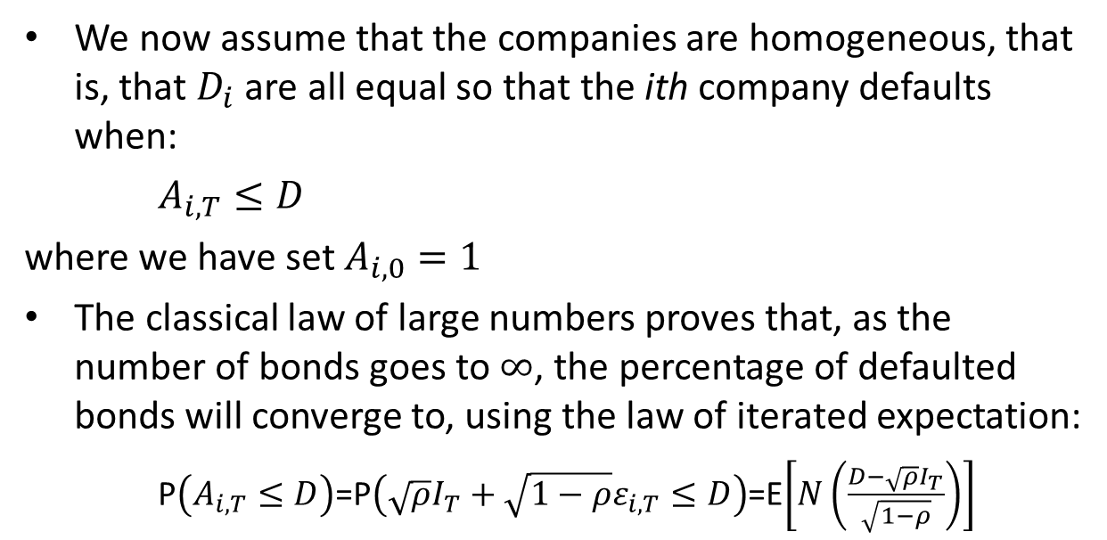
Vasicek’s Model Cont’d: the Homogeneous Large Bond Limit
We now assume that the companies are homogeneous, that is, that $D_{i}$ are all equal so that the ith company defaults when:
$A_{i,T}≤D$
where we have set $A_{i,0}=1$
The classical law of large numbers proves that, as the number of bonds goes to $∞$, the percentage of defaulted bonds will converge to, using the law of iterated expectation:
P$\left(A_{i,T}≤D\right)$=P$\left({\sqrt{ρ}I}_{T}+{\sqrt{1−ρ}ε}_{i,T}≤D\right)$=E$\left[N\left(\frac{D−{\sqrt{ρ}I}_{T}}{\sqrt{1−ρ}}\right)\right]$
Source: Kevin Atteson (Summer Road) -- Math 2796 Courant guest lecturer March 4, 2014

Slide 51
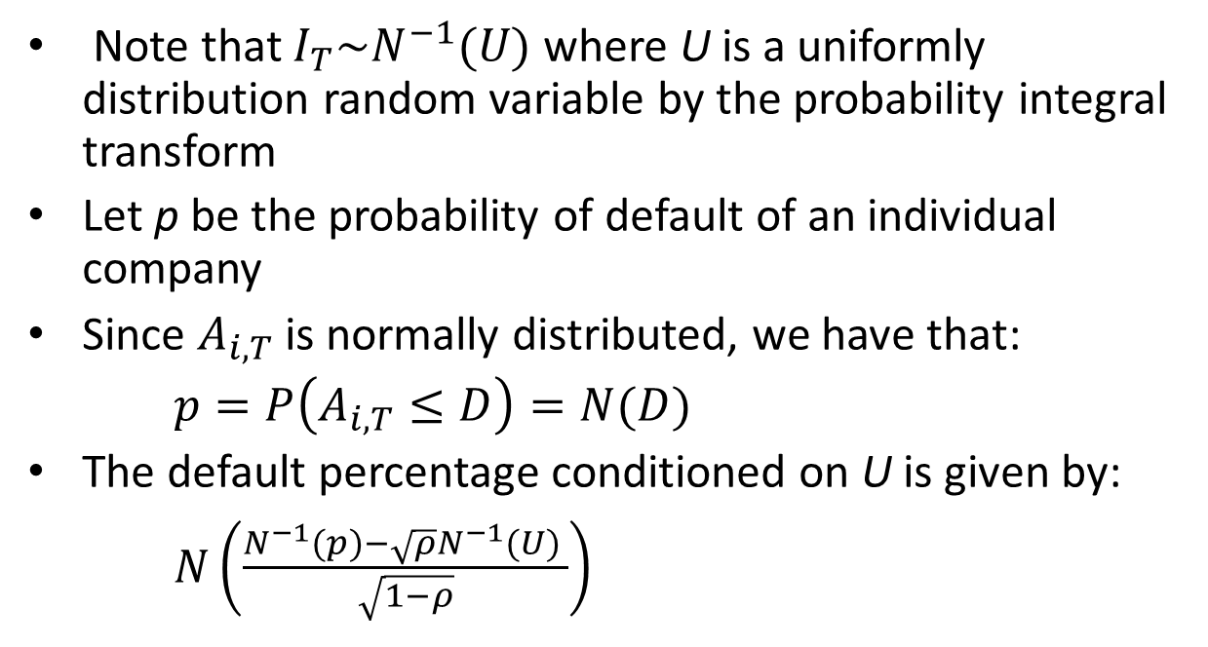
Vasicek’s Model: Final Steps
Note that $I_{T}\sim N^{−1}(U)$ where U is a uniformly distribution random variable by the probability integral transform
Let p be the probability of default of an individual company
Since $A_{i,T}$ is normally distributed, we have that:
$p=P\left(A_{i,T}≤D\right)=N(D)$
The default percentage conditioned on U is given by:
$N\left(\frac{N^{−1}(p)−\sqrt{ρ}N^{−1}(U) }{\sqrt{1−ρ}}\right)$
Source: Kevin Atteson (Summer Road) -- Math 2796 Courant guest lecturer March 4, 2014

Slide 52
Vasicek’s Model: CDO’s
Consider a CDO with:
5% chance of default per bond
40% attachment point
30% correlation across bonds
Using Vasicek’s model, the probability of default is about 0.5%
Using a methodology similar to this, the rating agency rated these bonds AAA
Over time, more and more risky subprime bonds were placed into CDO’s until there were CDO’s with mostly subprime bonds
These bonds would have even higher spreads than subprime bonds
Source: Kevin Atteson (Summer Road) -- Math 2796 Courant guest lecturer March 4, 2014

Slide 53
Vasicek’s Model: Adding an Additional Layer of Tranching
ABS CDO’s tranches are built on subprime bonds, not corporate bonds
Subprime bonds themselves involved credit tranching of subprime loans
Subprime loans are sensitive to systematic factors such as house prices and interest rates
It is important to incorporate systematic components into the models for subprime CDO’s
Source: Kevin Atteson (Summer Road) -- Math 2796 Courant guest lecturer March 4, 2014

Slide 54
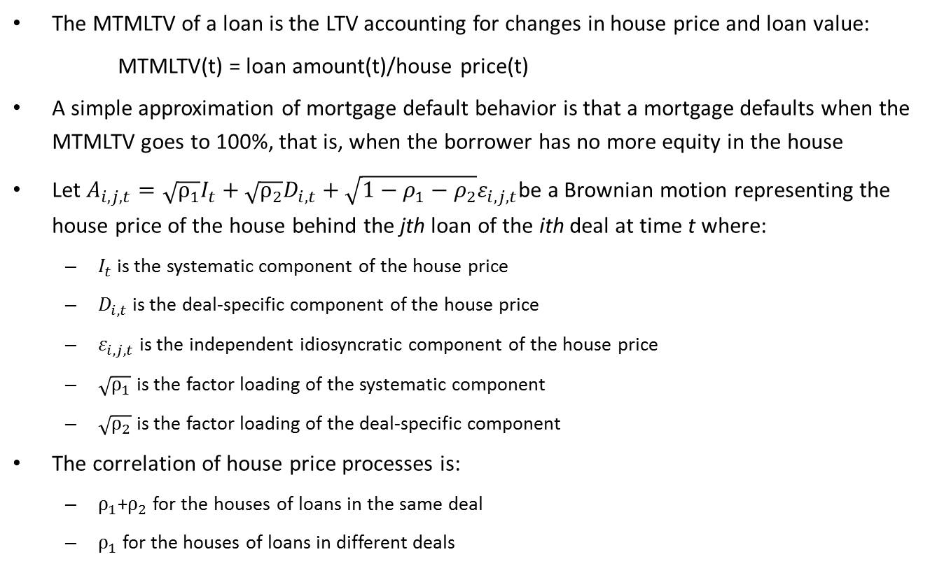
Vasicek’s Model for Mortgages
The MTMLTV of a loan is the LTV accounting for changes in house price and loan value:
MTMLTV(t) = loan amount(t)/house price(t)
A simple approximation of mortgage default behavior is that a mortgage defaults when the MTMLTV goes to 100%, that is, when the borrower has no more equity in the house
Let $A_{i,j,t}=\sqrt{ρ_{1}}I_{t}+\sqrt{ρ_{2}}D_{i,t}+{\sqrt{1−ρ_{1}−ρ_{2}}ε}_{i,j,t}$be a Brownian motion representing the house price of the house behind the jth loan of the ith deal at time t where:
$I_{t}$ is the systematic component of the house price
$D_{i,t}$ is the deal-specific component of the house price
$ε_{i,j,t}$ is the independent idiosyncratic component of the house price
$\sqrt{ρ_{1}}$ is the factor loading of the systematic component
$\sqrt{ρ_{2}}$ is the factor loading of the deal-specific component
The correlation of house price processes is:
$ρ_{1}$+$ρ_{2}$ for the houses of loans in the same deal
$ρ_{1}$ for the houses of loans in different deals
Source: Kevin Atteson (Summer Road) -- Math 2796 Courant guest lecturer March 4, 2014

Slide 55
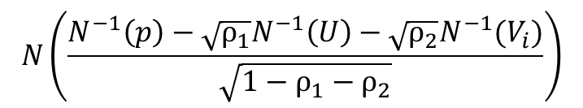
Vasicek’s Model for Mortgages: Cont’d
We analyze the multi-factor mortgage Vasicek model in a way similar to the single factor Vasicek model
Let U be a uniform random variable corresponding to the systematic component of house prices
Let V_{i} be a uniform random variable corresponding to the deal-specific component of house prices
The level of default of the ith deal is given by:
$$N\left(\frac{N^{−1}\left(p\right)−\sqrt{ρ_{1}}N^{−1}\left(U\right)−\sqrt{ρ_{2}}N^{−1}(V_{i})}{\sqrt{1−ρ_{1}−ρ_{2}}}\right)$$
Source: Kevin Atteson (Summer Road) -- Math 2796 Courant guest lecturer March 4, 2014

Slide 56
Vasicek’s Model for Subprime CDO’s
Given:
4% default rate
10% credit support for subprime bonds
40% attachment point for a CDO tranche
30% deal-specific correlation
0% systematic correlation
Vasicek’s model implies:
The subprime bonds default with 10% – 11% probability
The CDO tranche defaults with 0.2% - 0.3% probability
Source: Kevin Atteson (Summer Road) -- Math 2796 Courant guest lecturer March 4, 2014

Slide 57
Vasicek’s Model for Subprime CDO’s
Given:
4% default rate
10% credit support for subprime bonds
40% attachment point for a CDO tranche
0% deal-specific correlation
30% systematic correlation
Vasicek’s model implies:
The subprime bonds default with 10% – 11% probability
The CDO tranche defaults with 10% - 11% probability
Source: Kevin Atteson (Summer Road) -- Math 2796 Courant guest lecturer March 4, 2014

Slide 58
Student Loan ABS
We will not spend much time on SLABS because there are no new issuances. There are still bonds issued in years past
Source: J. Kuropatkin

Slide 59
FFELP Student Loan ABS
We will not spend much time on SLABS because there are no new issuances. There are still bonds issued in years past
US Dept of Education program
Loans originated through this program have 97%-100% guarantee (depending on vintage) from US Government
FFELP ABS senior-subordinated structure:
Health Care and Education Reconciliation Act of 2010 eliminated the FFELP program.
All federal student loans now under the Federal Direct Loan Program (FDLP)
On US Government’s balance sheet rather than securitized
Loans originated in the past are still being securitized
Rehabilitated loans
Loans currently funded in warehouse facilities
Loans originated before 10/1/93: 100% guarantee
10/1/93 - 7/1/06: 98% guarantee
After 7/1/06; before 7/1/10: 97% guarantee
Source: J. Kuropatkin
Source: SIFMA
Source: BAML Research

Slide 60
Student Loan ABS
Student Loan ABS Outstanding
Source: SIFMA
Loans originated pre-2010 are still being securitized
Restructurings of ABS
Rehabilitated loans
Loans funded in warehouse facilities
Private label issuance fairly stable
Student Loan ABS Issuance
Source: BAML Research

Slide 61
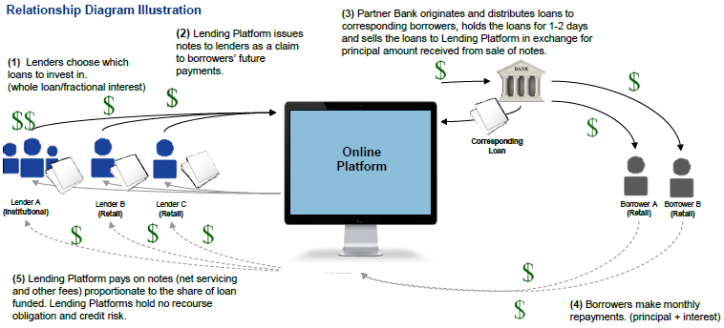
Market Place Lending
What is it?
An online platform that matches borrowers and lenders
Quicker lending process than traditional bank lending
Serves “underserved” populations
“Unsecured” lending
Lenders are anonymous to borrowers
Borrowers are anonymous to lenders
Source: MarketPlace Lending & Securitization, Dec. 17, 2015, Morgan Stanley Research

Slide 62
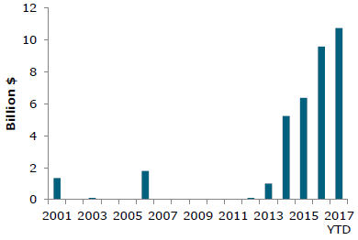
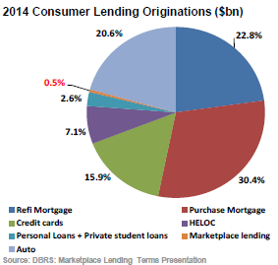
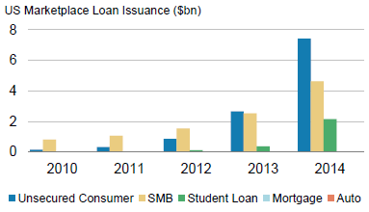
MPL: Overview of U.S.
Tiny % of U.S. Consumer Lending Origination (2014)
Sectors: Unsecured Consumer Lending, Small/Medium Business, Student Loans
Growing rapidly, but securitization levels are low
Issuance
Source: Wells Fargo Securities
Source: MarketPlace Lending & Securitization, May 19 & Dec 17, 2015, Morgan Stanley Research

Slide 63
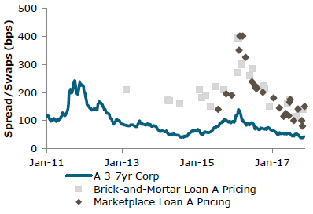
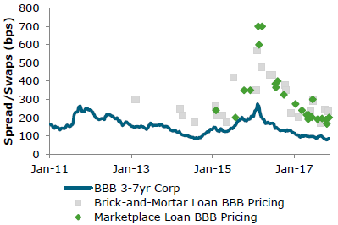
MPL vs Corporate Bonds
Much less liquid than corporate bonds
Spreads much wider than corporate bond spreads
Source: Wells Fargo Securities

Slide 64
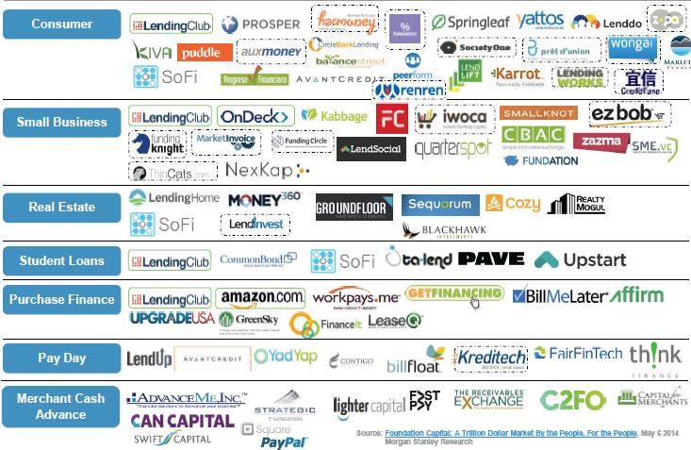
MPL: Key Players U.S. as of mid-2014
Source: MarketPlace Lending & Securitization, Dec. 17, 2015, Morgan Stanley Research

Slide 65

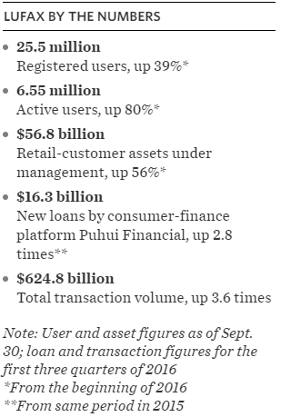
MPL: Key Players Globally
Source: Wall Street Journal; Feb 22, 2017

Slide 66
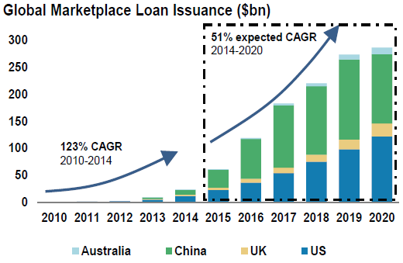
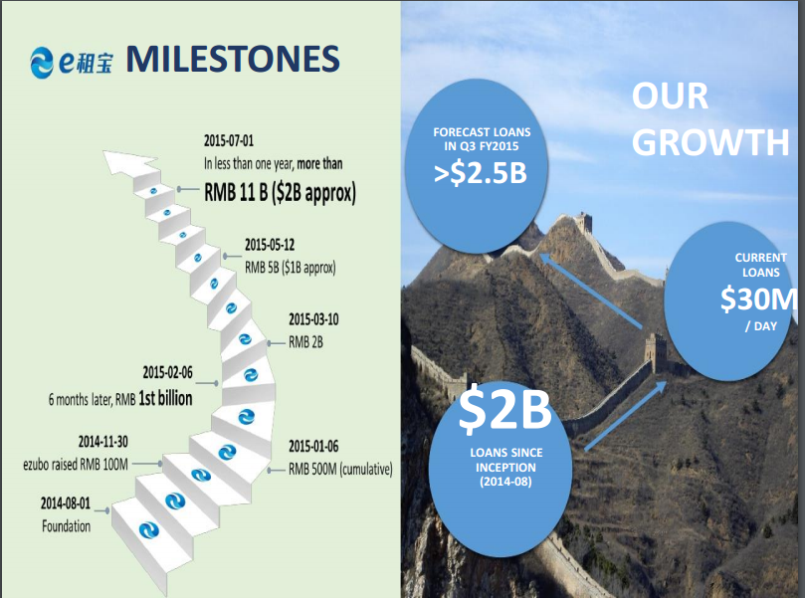

MPL: Global Snapshot
$24Bn in lending (2014)
USA: $12Bn, followed by China and UK
Examples of offerings from a MarketPlace Lender in China: E租宝
Source: The internet, silly.

Slide 67

MPL: Unexpected Risks
e租宝曝500亿元庞氏骗局，超95%项目虚假
香港——中国一家网络金融公司诈骗投资者资金500多亿人民币（约合76亿美元），把巨额金钱花在赠送他人和支付高工资上，还埋藏证据，正在调查这个当局称之为巨大庞氏骗局的当地警方说。
这些指控让中国的网络金融行业蒙上阴影，尽管这一利润丰厚的行业已产生了全球领导者，但当局表示，行业中也出现了越来越多的欺诈案和昙花一现的公司。
据中国官方的新华通讯社报道，中国官员说，昔日的行业主力e租宝，向其近100万的投资者提供的投资产品大多数是假的。报道称，当局已在中国东部省份安徽逮捕了21人，关闭了e租宝融资平台的一些操作，安徽是e租宝总部所在地。
来源: 纽约中文时报

Slide 68


MPL: Unexpected Risks
Online Lender Ezubao Took $7.6 Billion in Ponzi Scheme, China Says
HONG KONG — A Chinese online finance company bilked investors out of more than $7.6 billion, spent lavishly on gifts and salaries and buried the evidence, according to local authorities who described the operation as an enormous Ponzi scheme.
The accusations throw a shadow over China’s online finance industry, a lucrative area for many global leaders in the sector, but one that the authorities say has also drawn a growing number of cases of fraud and flameouts.
Chinese officials say that the online company, Ezubao, once a dynamo of the industry, offered mostly fake investment products to its nearly one million investors, according to the state-run Xinhua news agency. The authorities arrested 21 people in Anhui, the eastern Chinese province where Ezubao is based, and closed some of the platform’s operations, the agency reported on Sunday.
The state broadcaster aired footage on Monday of suitcases full of cash and excavators unearthing evidence in a fraud case involving an online finance company.
By REUTERS on Publish Date February 1, 2016. Photo by Agence France-Presse — Getty Images. http://nyti.ms/1nK8Xhk
Source:

Slide 69
MPL: Unexpected Risks
Other failed firms
Uprosper
Zhongjin Capital Management
Shanghai Kuailu Investment Group
Source:

Slide 70
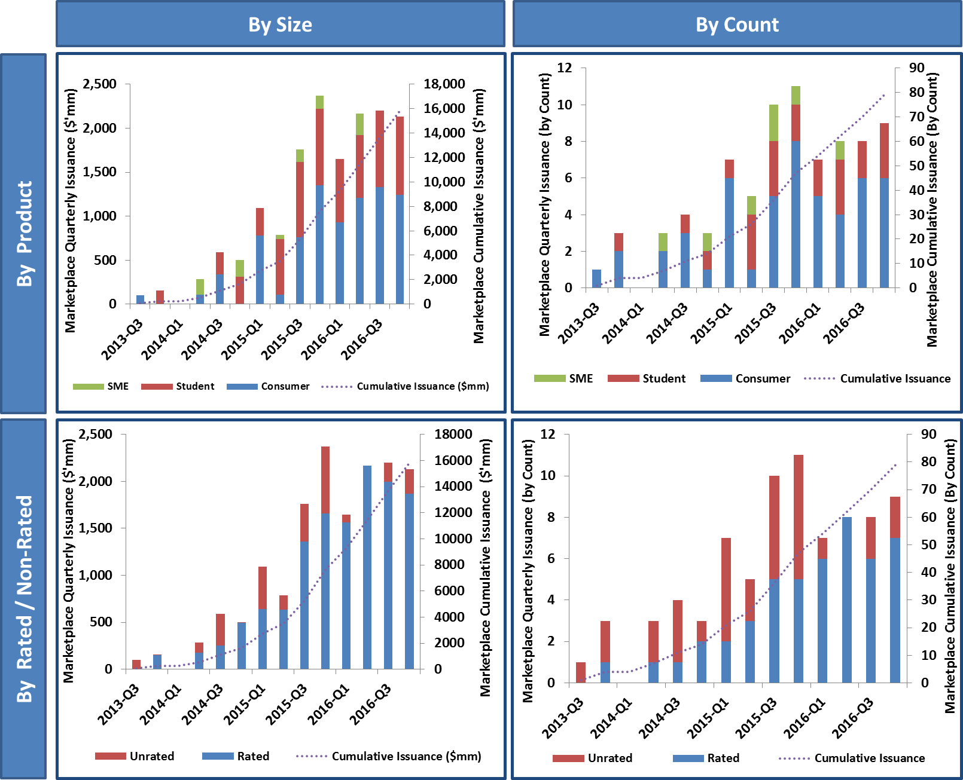
MPL: U.S. Securitization Trends
Limited performance history
Source: Morgan Stanley Consumer ABS Strategy: Marketplace Lending Deal Tracker – 2016 Full Year Recap, Jan 6, 2017

Slide 71
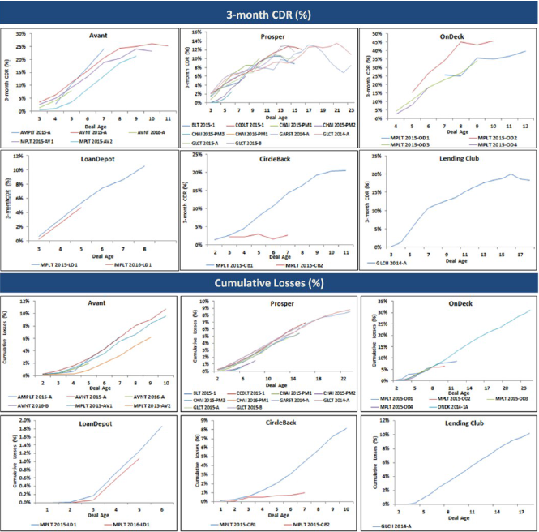
MPL: Default Rates, Cumulative Losses in Securitizations
High delinquencies and losses
Source: Morgan Stanley Consumer ABS Strategy: Marketplace Lending: Structure Matters July 29, 2016

Slide 72
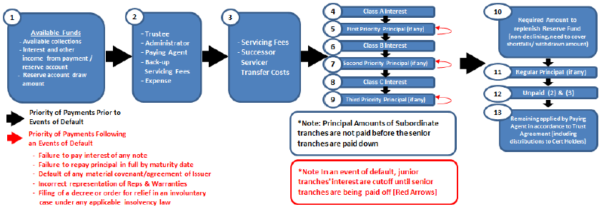
MPL: Securitization Structures
To compensate for high delinquencies and losses
Priority of payments
Triggers
Reserve account
Source: Morgan Stanley Consumer ABS Strategy: Marketplace Lending: Structure Matters July 29, 2016

Slide 73
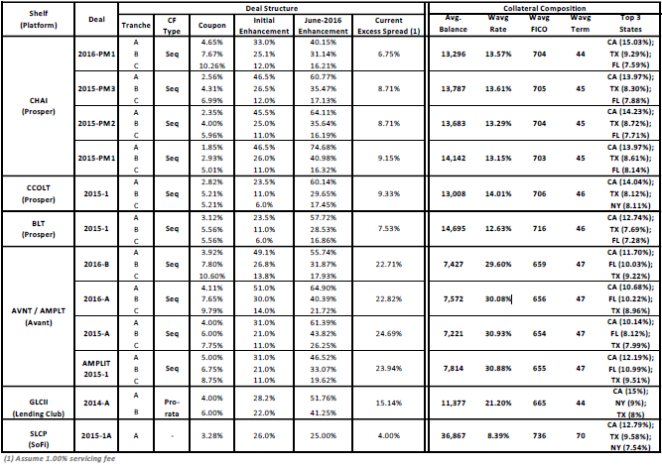
MPL: Securitization Structures
To compensate for high delinquencies and losses
Overcollateralization 6-15%
Significant subordination protection
Excess spread 6-25%
Source: Morgan Stanley Consumer ABS Strategy: Marketplace Lending: Structure Matters July 29, 2016

Slide 74
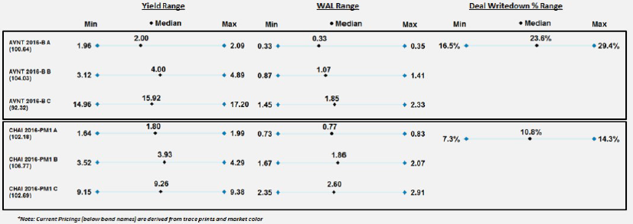
MPL: Securitization Structures
To compensate for high delinquencies and losses
Short duration structures
Source: Morgan Stanley Consumer ABS Strategy: Marketplace Lending: Structure Matters July 29, 2016

